Slide 1
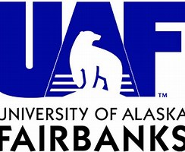
CHACHA Project Overview
“Collaborative Research:
CHemistry in the Arctic: Clouds, Halogens, and Aerosols (CHACHA)”
A collaborative research project involving six institutions:
Paul B. Shepson, Stony Brook University (Lead PI)
Kerri A. Pratt, University of Michigan
Sara Lance, University at Albany
William R. Simpson, University of Alaska, Fairbanks
Jose D. Fuentes, Penn State University
Christine A. Hrycyna, Purdue University

Slide 2
CHACHA aims to assess the extent to which Arctic change, particularly sea ice loss and increased fossil fuel extraction in the New Arctic, modifies multiphase halogen, nitrogen, and sulfur chemistry, and to assess the role of aerosols and clouds in that chemistry.

Slide 3
The CHACHA Team proposes an aircraft-based observation and modeling approach, with aircraft payloads, flight plans, and subsequent 1-D modeling designed to test the following three project hypotheses:
Hypothesis 1: Open sea ice leads are the largest source of early spring aerosol mass to the Arctic boundary layer, affecting aerosol and cloud chemical composition, ozone, and other gases.
Hypothesis 2: Oil and gas extraction activities contribute to gas emissions that significantly modify natural halogen chemistry, impacting multiphase halogen recycling and activation, as well as the fate of NO_{x} and ozone.
Hypothesis 3: Atmospheric oxidative processing of sulfur, nitrogen and other chemical species differs between clear-sky conditions, and those impacted by in-cloud chemical processing.

Slide 4
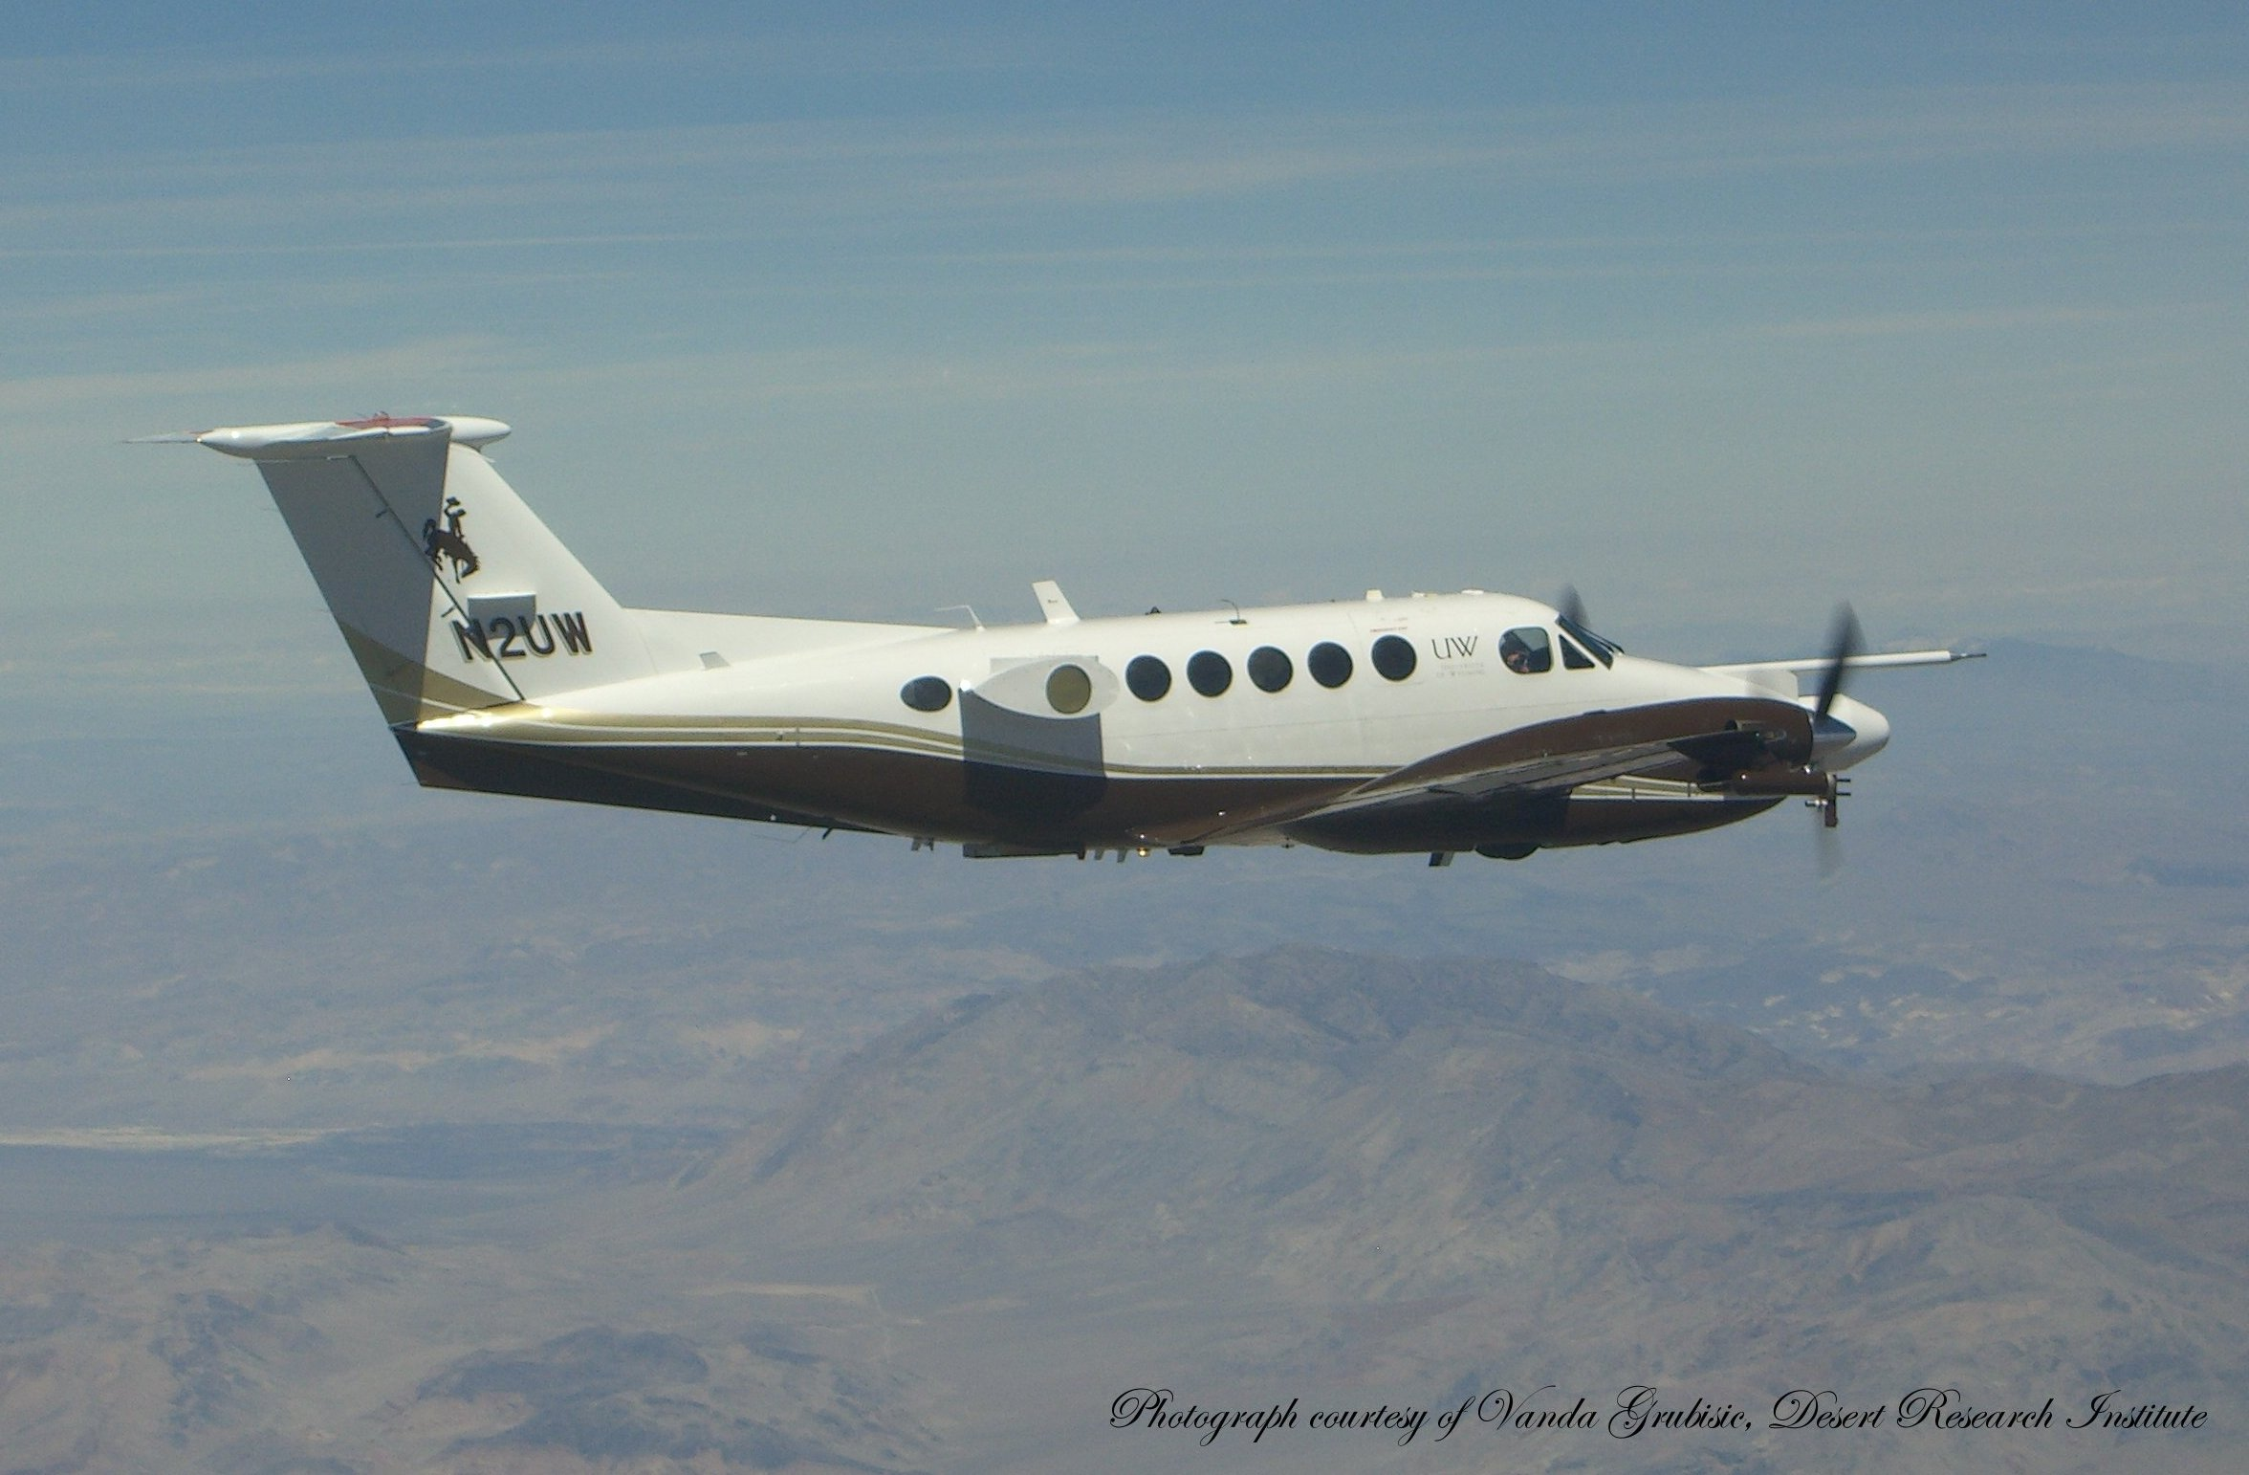
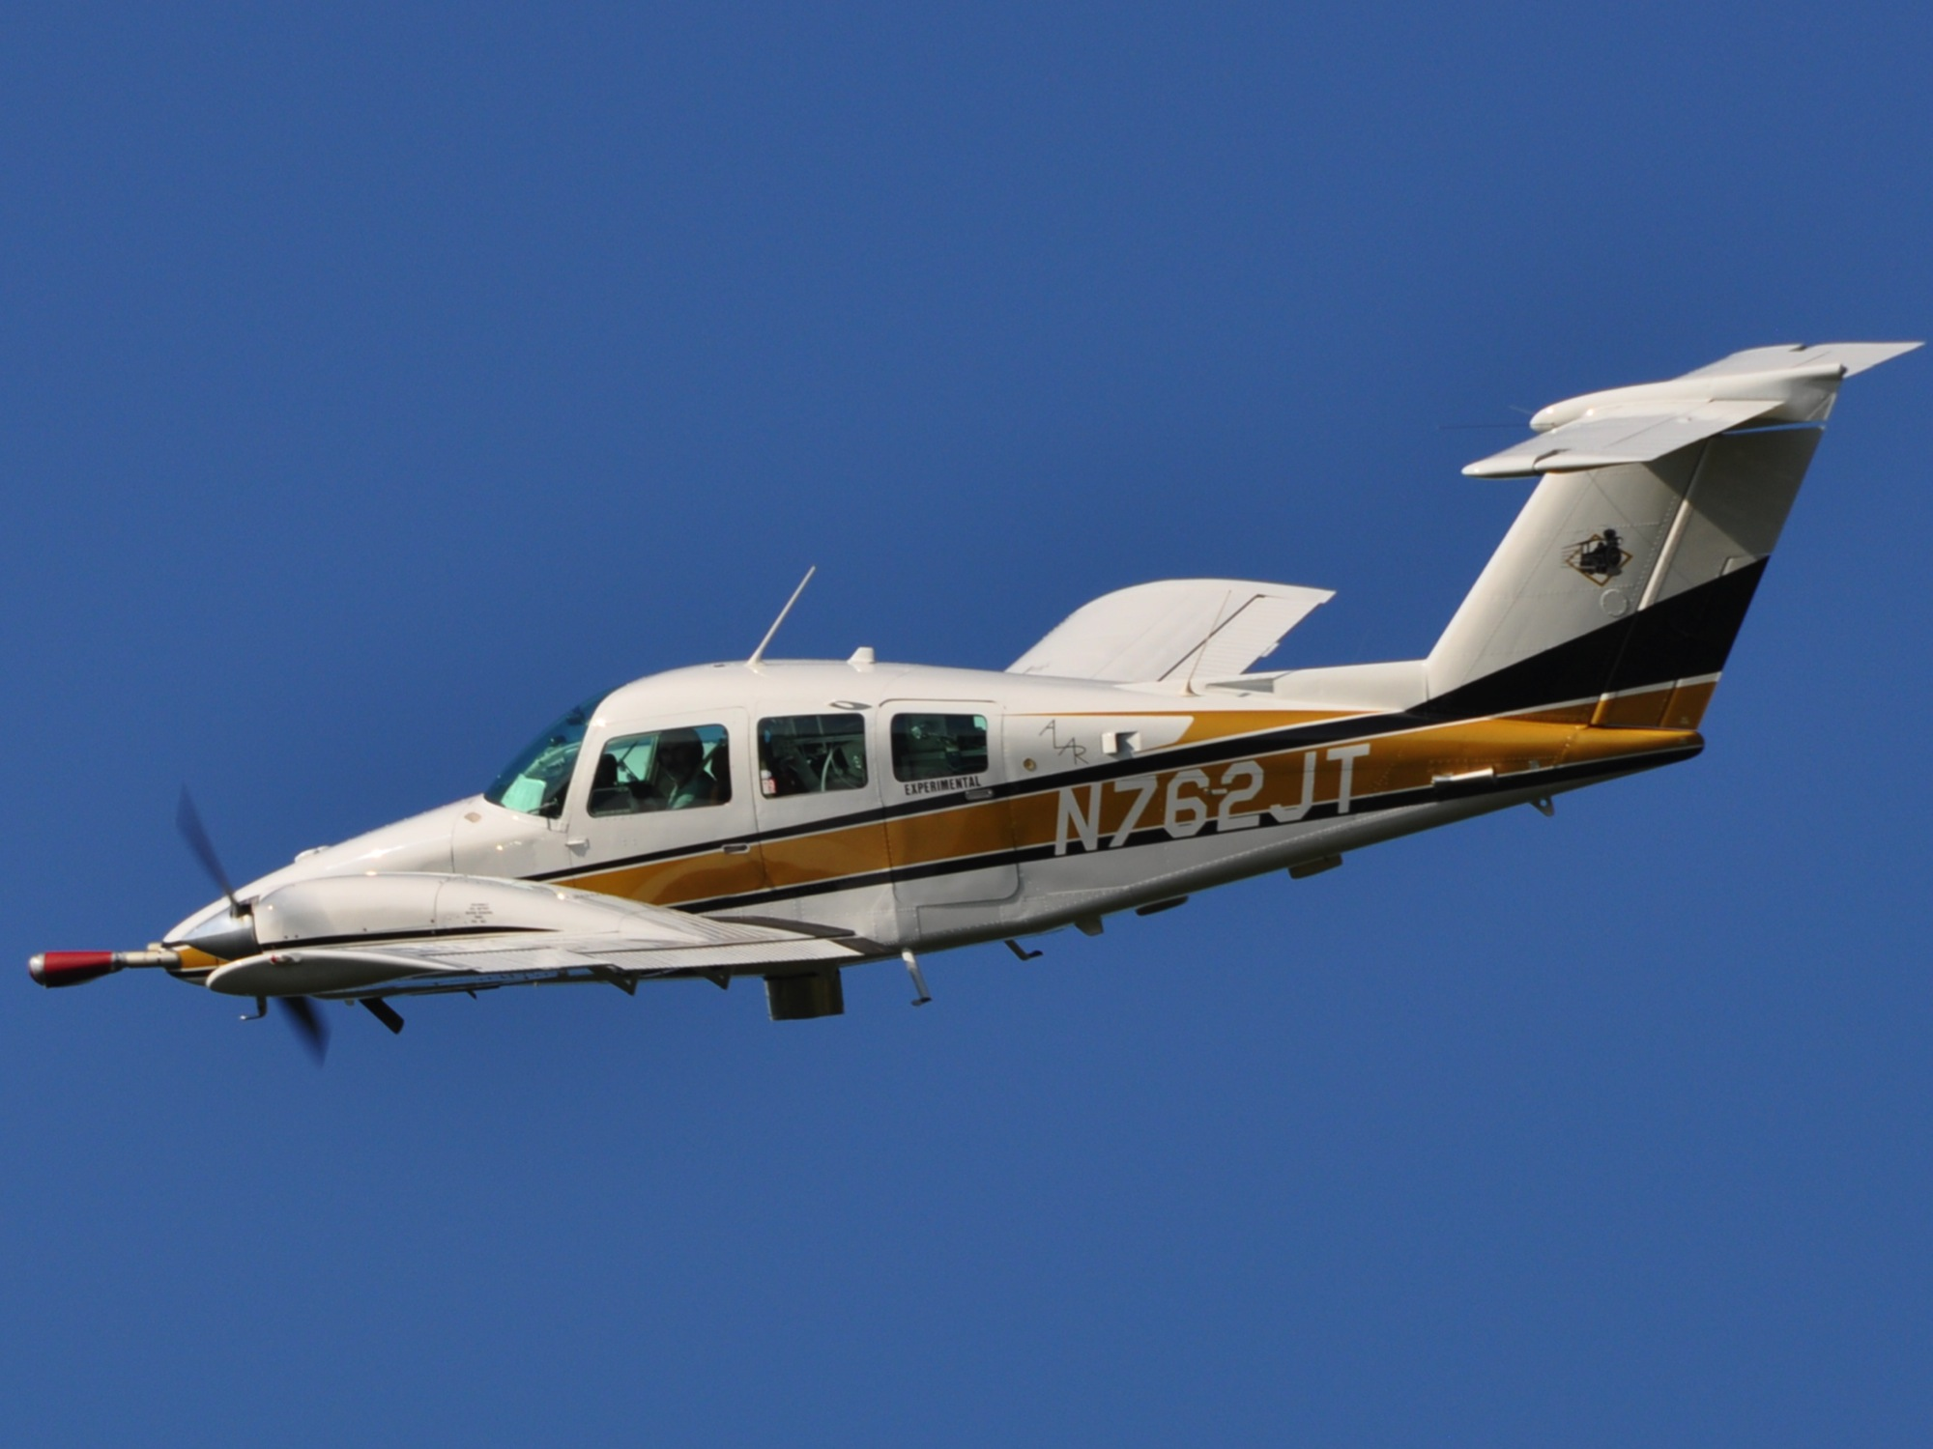
We propose to conduct eight weeks of observations across the
Alaskan Arctic during spring using two aircraft, the
University of Wyoming King Air and
the Purdue University Duchess (ALAR).
Purdue ALAR

Slide 5
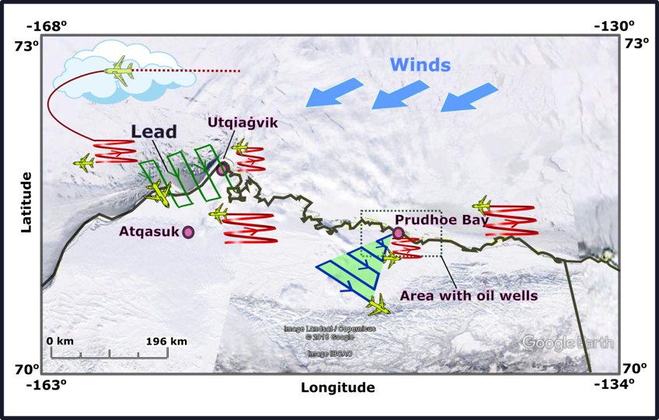
CHACHA is proposed to be conducted between February and
April, 2021, flying between Barrow and Deadhorse airports.
A simplified, conceptual flight plan (multiple plans) is shown below.

Slide 6
The instrumentation payload and prospective flight plans have
been previously reviewed by Univ. of Wyoming staff.
Broader Impacts
Mentoring/Training: 2 female early-career co-PIs, 2 post-docs, 4 PhD students, 4+ undergraduate students.
CHACHA Aircraft Open House: Public open houses for the North Slope Borough (Utqiaġvik) and Fairbanks, AK communities to visit the UWYO King Air and Purdue ALAR, meet CHACHA scientists and project engineers/staff, and learn about Arctic change
North Slope Science Fair: Project team participation in science fair judging and community science lectures, facilitated by UIC-Science
North Slope Borough K-12 Teacher Workshop: Collaborative workshop with K-12 educators to build new science curriculum based on Arctic snow chemistry research to address the Next Generation Science Standards, as requested by UIC-Science
Additional Public Outreach: Social media of CHACHA activities; integration of CHACHA into course development; outreach for underrepresented groups near PI’s home communities

